Slide 1
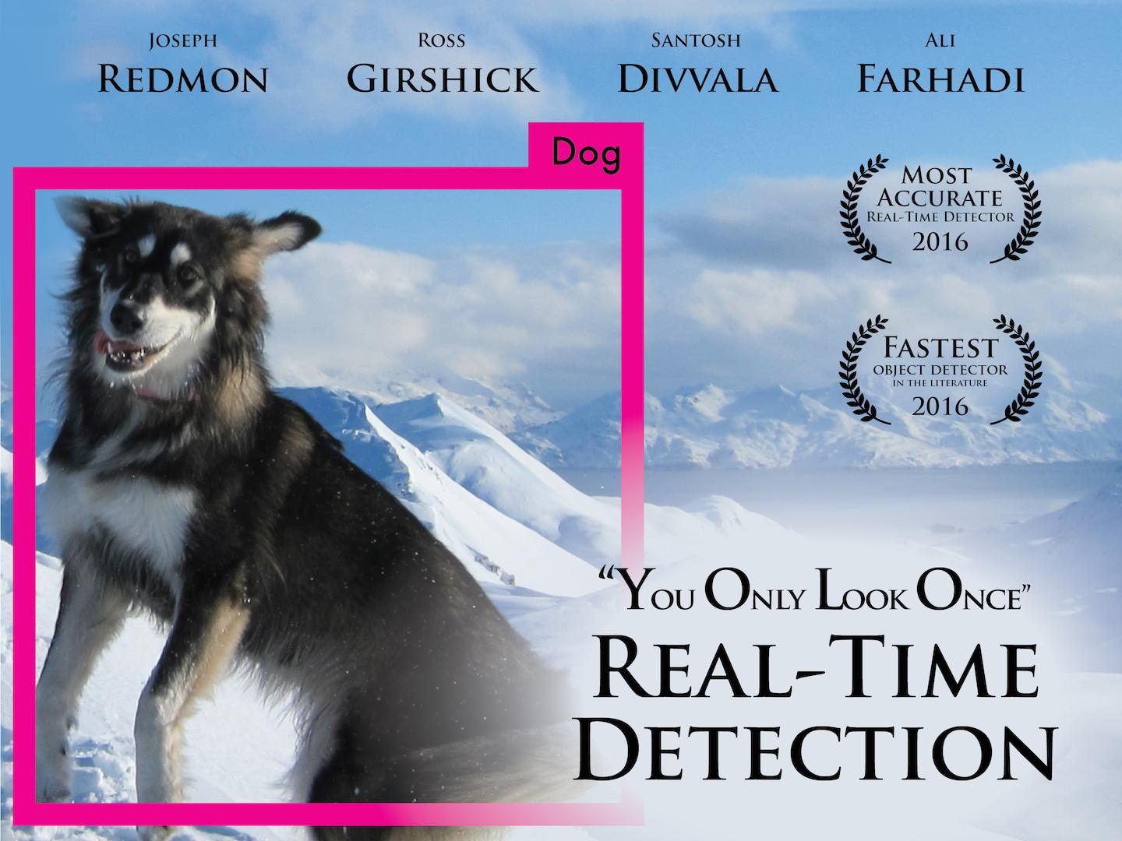

Slide 2
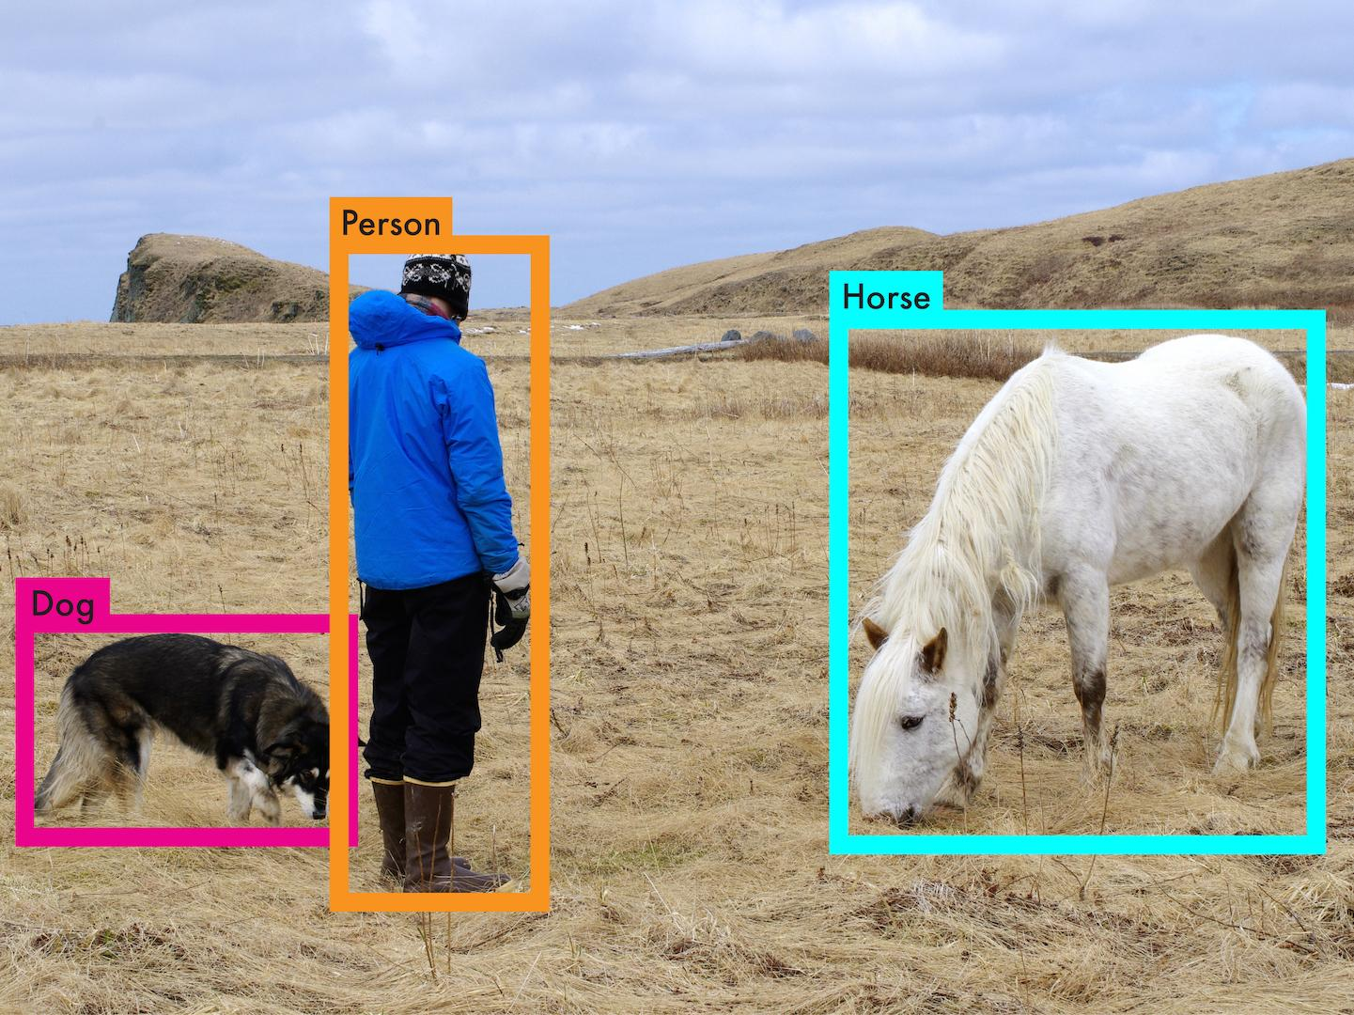

Slide 3
Accurate object detection is slow!
 | Pascal 2007 mAP | Speed
DPM v5 | 33.7 | .07 FPS | 14 s/img

Slide 4
Accurate object detection is slow!
 | Pascal 2007 mAP | Speed
DPM v5 | 33.7 | .07 FPS | 14 s/img
R-CNN | 66.0 | .05 FPS | 20 s/img

Slide 5
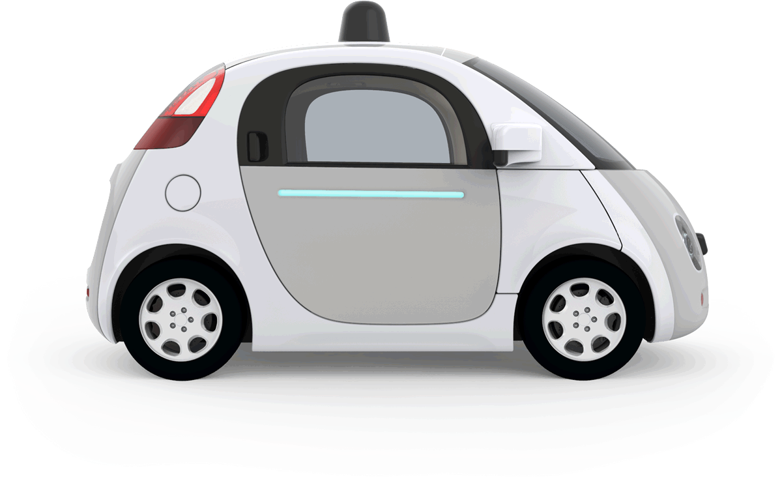
Accurate object detection is slow!
 | Pascal 2007 mAP | Speed
DPM v5 | 33.7 | .07 FPS | 14 s/img
R-CNN | 66.0 | .05 FPS | 20 s/img
⅓ Mile, 1760 feet

Slide 6
Accurate object detection is slow!
 | Pascal 2007 mAP | Speed
DPM v5 | 33.7 | .07 FPS | 14 s/img
R-CNN | 66.0 | .05 FPS | 20 s/img
Fast R-CNN | 70.0 | .5 FPS | 2 s/img
176 feet

Slide 7
Accurate object detection is slow!
 | Pascal 2007 mAP | Speed
DPM v5 | 33.7 | .07 FPS | 14 s/img
R-CNN | 66.0 | .05 FPS | 20 s/img
Fast R-CNN | 70.0 | .5 FPS | 2 s/img
Faster R-CNN | 73.2 | 7 FPS | 140 ms/img
8 feet
12 feet

Slide 8
Accurate object detection is slow!
 | Pascal 2007 mAP | Speed
DPM v5 | 33.7 | .07 FPS | 14 s/img
R-CNN | 66.0 | .05 FPS | 20 s/img
Fast R-CNN | 70.0 | .5 FPS | 2 s/img
Faster R-CNN | 73.2 | 7 FPS | 140 ms/img
YOLO | 63.4 | 45 FPS | 22 ms/img
2 feet

Slide 9
Accurate object detection is slow!
 | Pascal 2007 mAP | Speed
DPM v5 | 33.7 | .07 FPS | 14 s/img
R-CNN | 66.0 | .05 FPS | 20 s/img
Fast R-CNN | 70.0 | .5 FPS | 2 s/img
Faster R-CNN | 73.2 | 7 FPS | 140 ms/img
YOLO | 63.4 69.0 | 45 FPS | 22 ms/img
2 feet

Slide 10
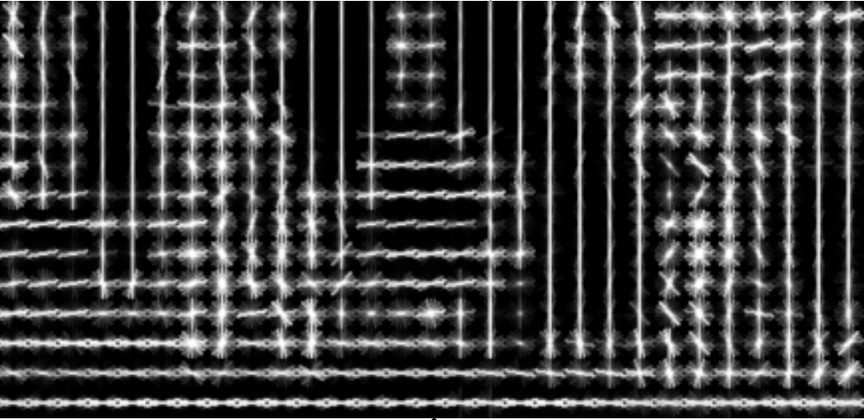
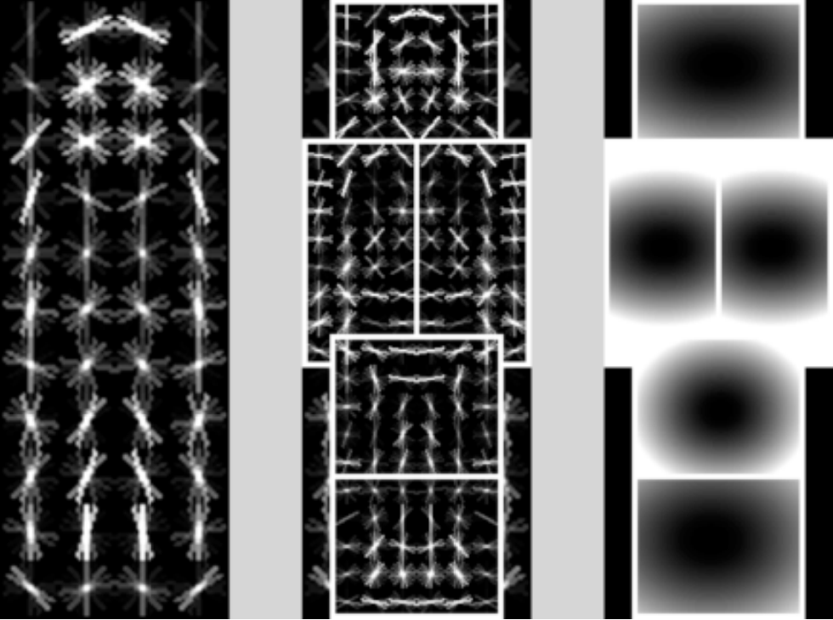
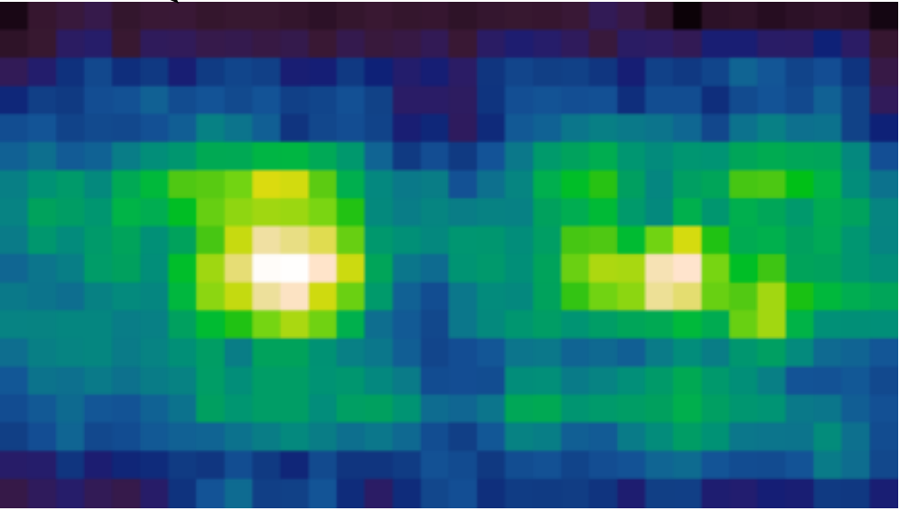
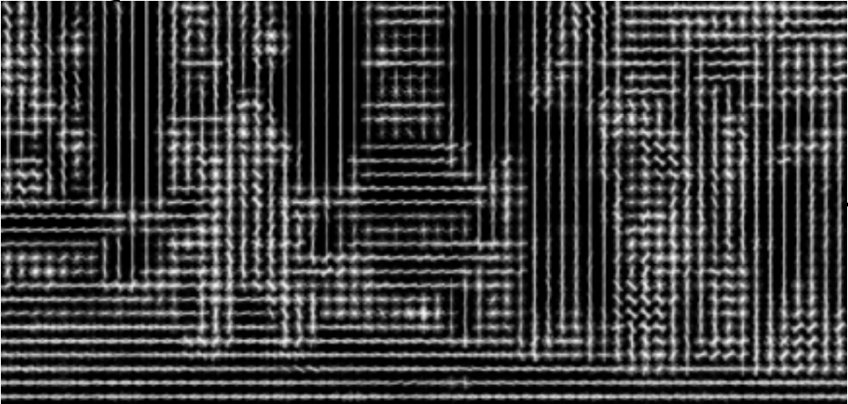
DPM: Deformable Part Models

Slide 11
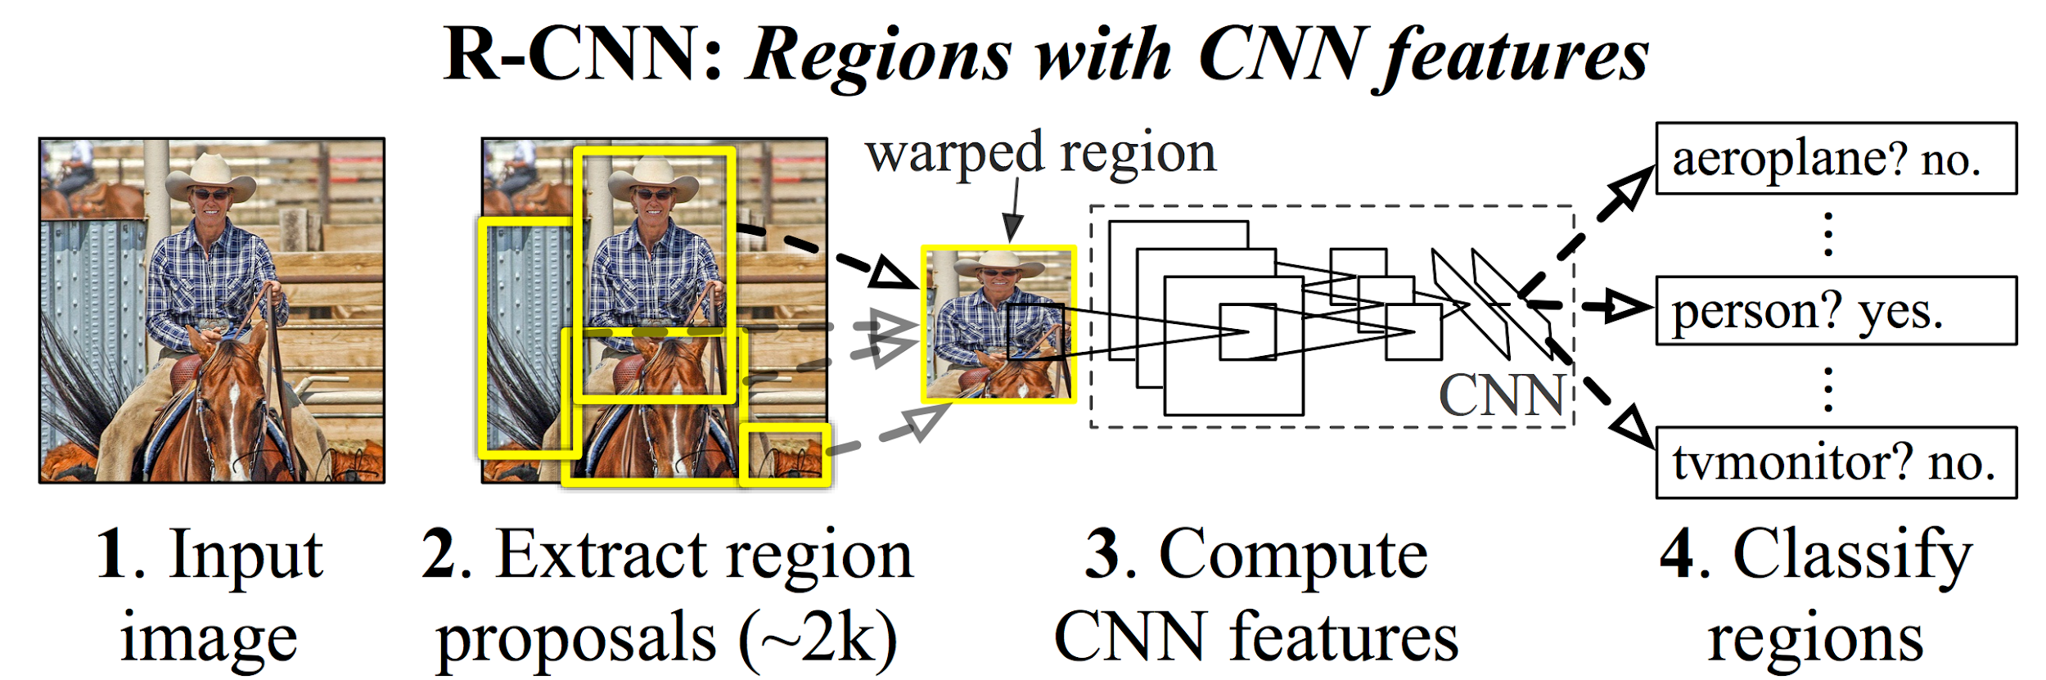

Slide 12
Sliding window, DPM, R-CNN all train region-based classifiers to perform detection
DPM: Deformable Part Models

Slide 13
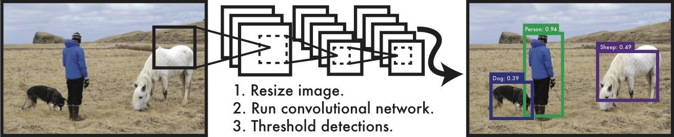

Slide 14
With YOLO, you only look once at an image to perform detection
YOLO: You Only Look Once

Slide 15
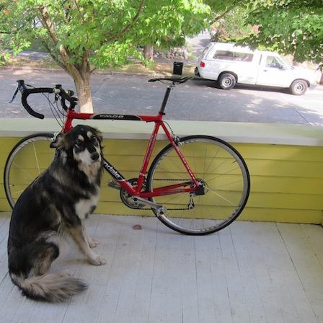

Slide 16
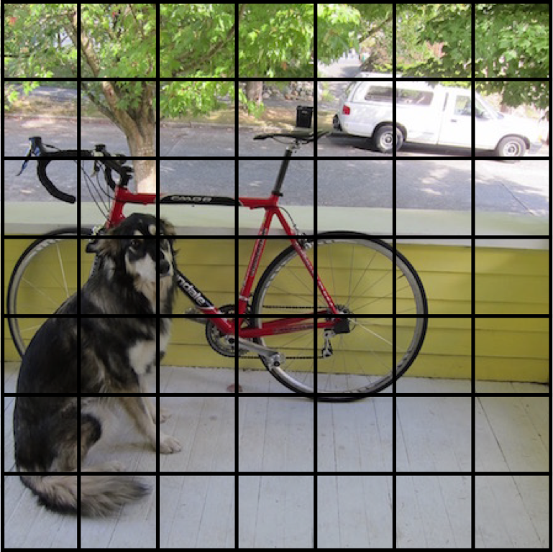
We split the image into a grid

Slide 17
Each cell predicts boxes and confidences: P(Object)

Slide 18
Each cell predicts boxes and confidences: P(Object)

Slide 19
Each cell predicts boxes and confidences: P(Object)

Slide 20
Each cell predicts boxes and confidences: P(Object)

Slide 21
Each cell predicts boxes and confidences: P(Object)

Slide 22
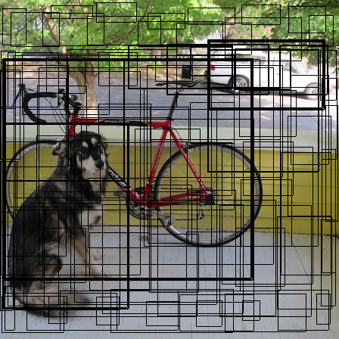
Each cell predicts boxes and confidences: P(Object)

Slide 23
Each cell also predicts a class probability.

Slide 24
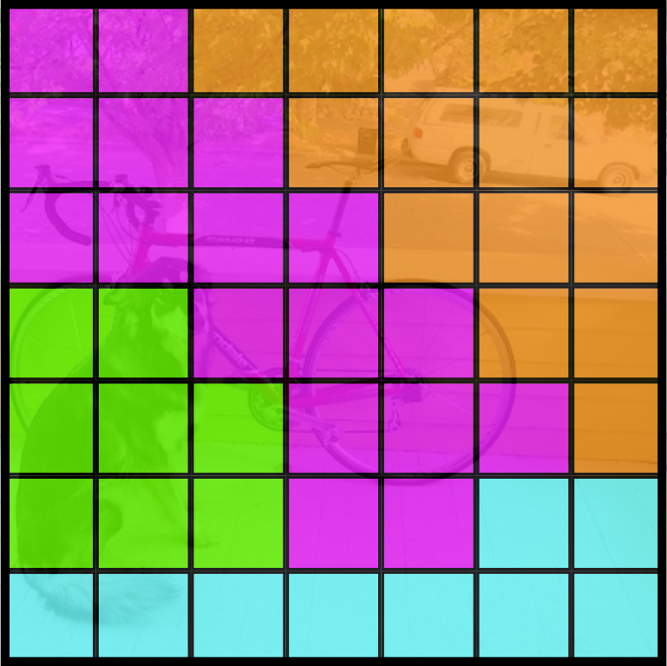
Each cell also predicts a class probability.
Bicycle
Car
Dog
Dining Table

Slide 25
Conditioned on object: P(Car | Object)
Bicycle
Car
Dog
Dining Table

Slide 26
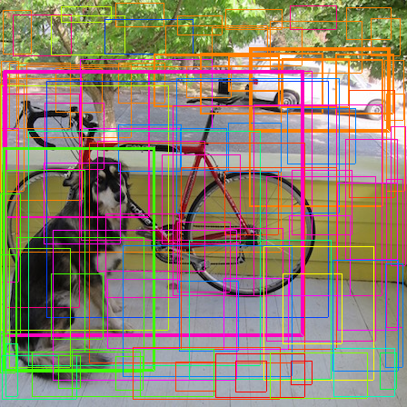
Then we combine the box and class predictions.

Slide 27
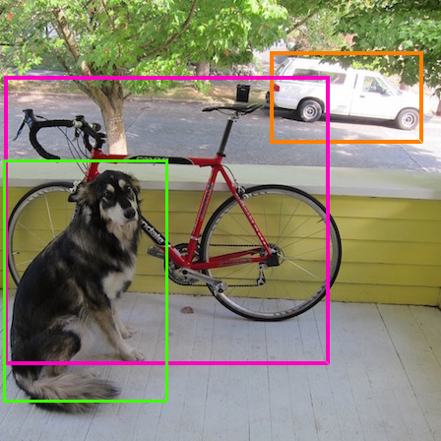
Finally we do NMS and threshold detections

Slide 28
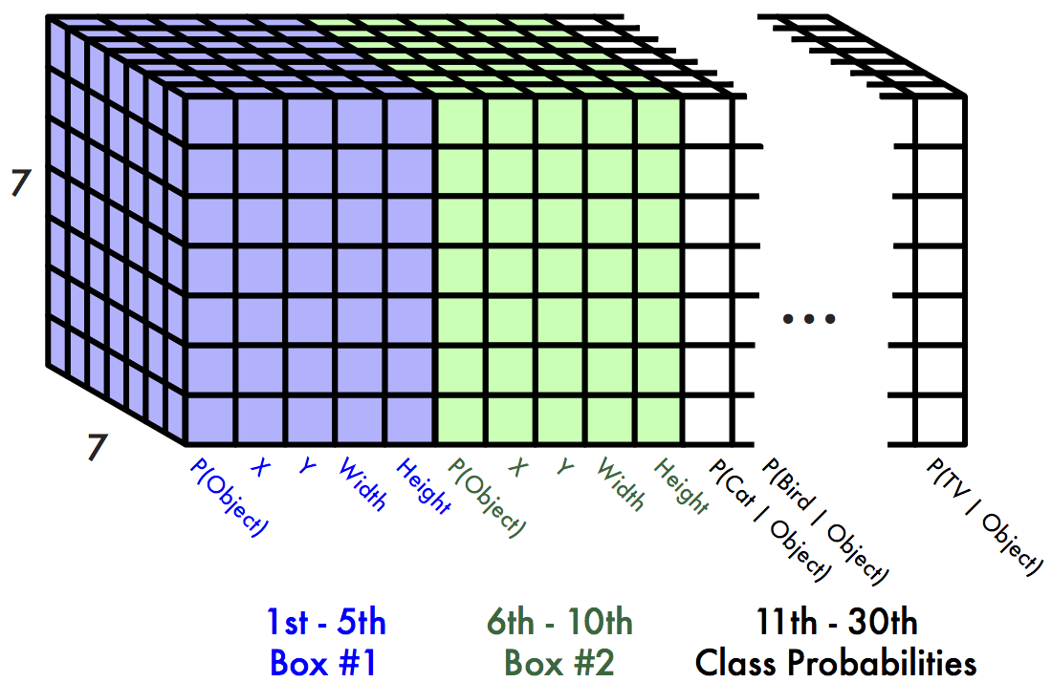
This parameterization fixes the output size
Each cell predicts:
For each bounding box:
4 coordinates (x, y, w, h)
1 confidence value
Some number of class probabilities
For Pascal VOC:
7x7 grid
2 bounding boxes / cell
20 classes
7 x 7 x (2 x 5 + 20) = 7 x 7 x 30 tensor = 1470 outputs

Slide 29
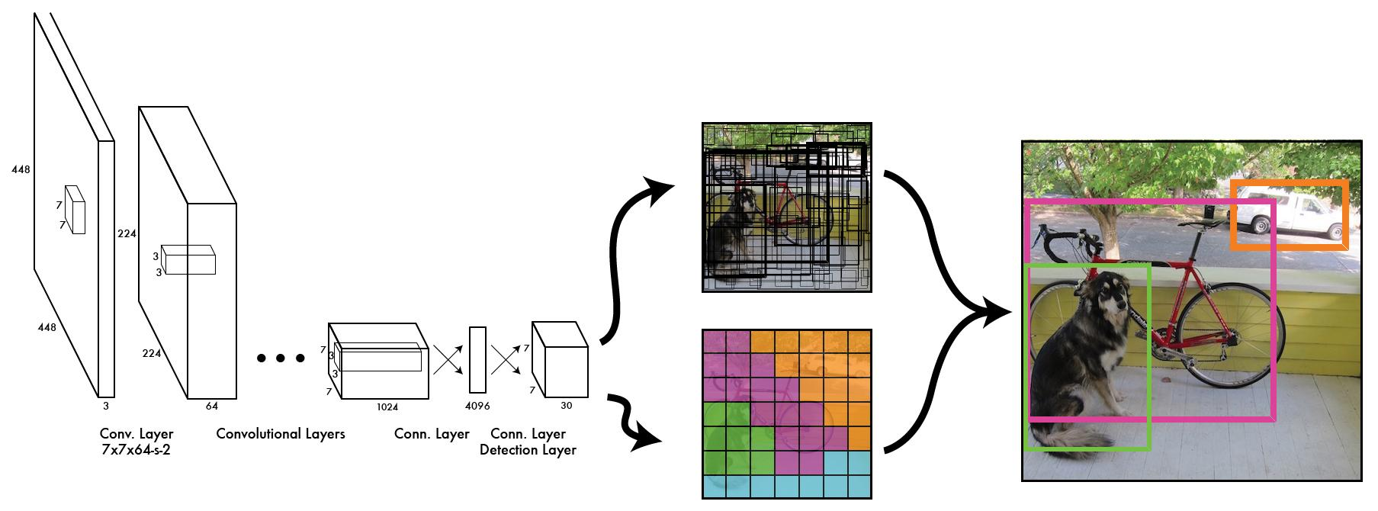
Thus we can train one neural network to be a whole detection pipeline

Slide 30
During training, match example to the right cell

Slide 31
During training, match example to the right cell

Slide 32
Adjust that cell’s class prediction
Dog = 1
Cat = 0
Bike = 0
...

Slide 33
Look at that cell’s predicted boxes

Slide 34
Find the best one, adjust it, increase the confidence

Slide 35
Find the best one, adjust it, increase the confidence

Slide 36
Find the best one, adjust it, increase the confidence

Slide 37
Decrease the confidence of other boxes

Slide 38
Decrease the confidence of other boxes

Slide 39
Some cells don’t have any ground truth detections!

Slide 40
Some cells don’t have any ground truth detections!

Slide 41
Decrease the confidence of these boxes

Slide 42
Decrease the confidence of these boxes

Slide 43
Don’t adjust the class probabilities or coordinates

Slide 44
We train with standard tricks:
Pretraining on Imagenet
SGD with decreasing learning rate
Extensive data augmentation
For details, see the paper

Slide 45
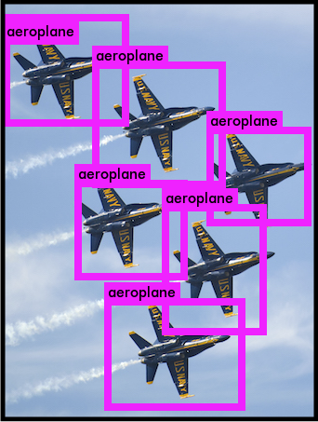
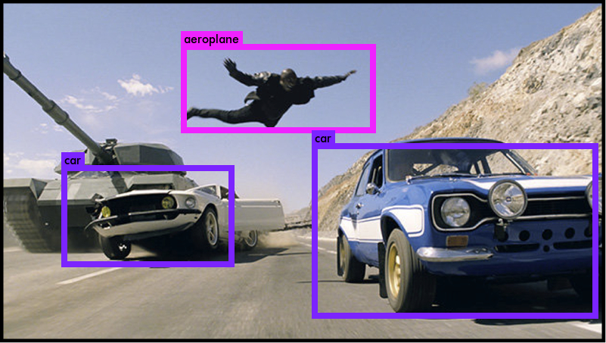
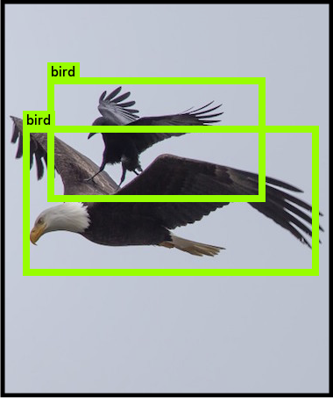
YOLO works across a variety of natural images

Slide 46
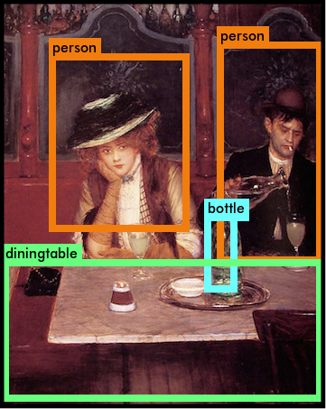
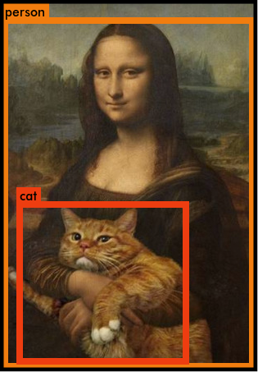
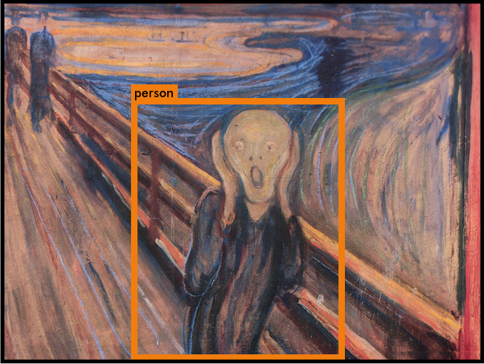
It also generalizes well to new domains (like art)

Slide 47
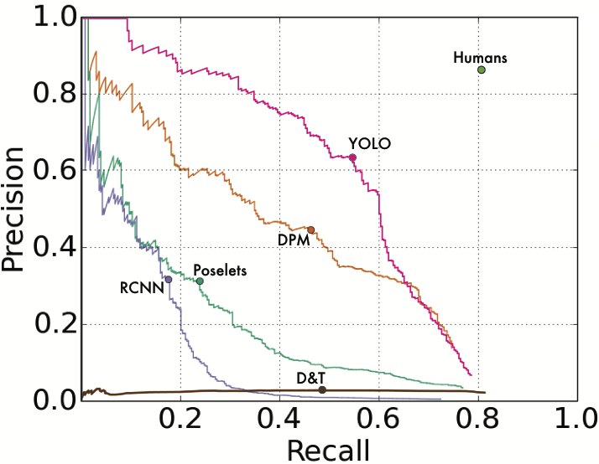
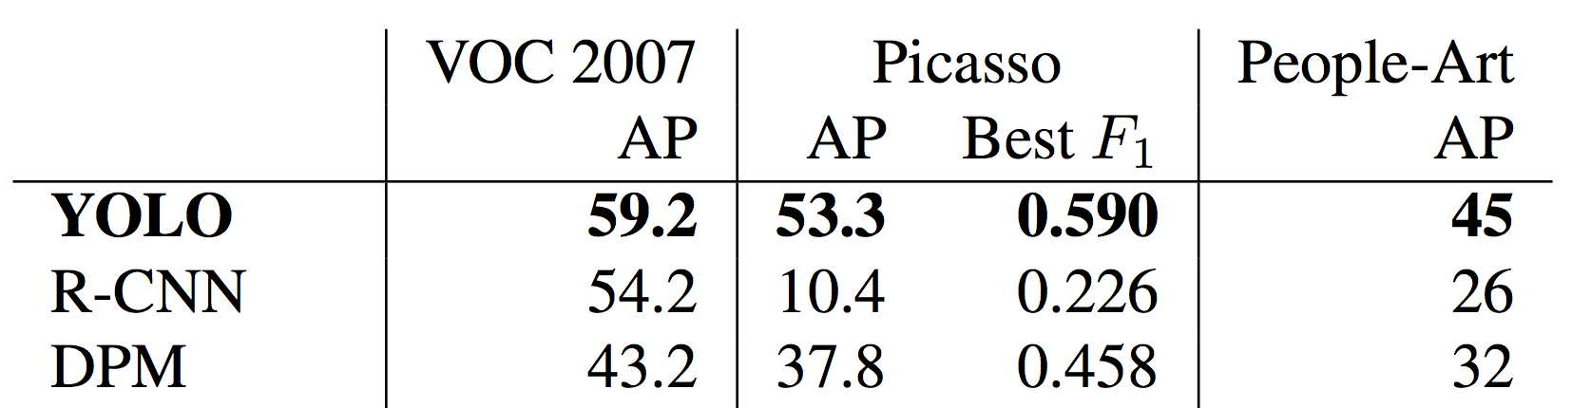
YOLO outperforms methods like DPM and R-CNN when generalizing to person detection in artwork
S. Ginosar, D. Haas, T. Brown, and J. Malik. Detecting people in cubist art. In Computer Vision-ECCV 2014 Workshops, pages 101–116. Springer, 2014.
H. Cai, Q. Wu, T. Corradi, and P. Hall. The cross-depiction problem: Computer vision algorithms for recognising objects in artwork and in photographs.

Slide 48



Code available! pjreddie.com/yolo
 | Pascal 2007 mAP | Speed
DPM v5 | 33.7 | .07 FPS | 14 s/img
R-CNN | 66.0 | .05 FPS | 20 s/img
Fast R-CNN | 70.0 | .5 FPS | 2 s/img
Faster R-CNN | 73.2 | 7 FPS | 140 ms/img
YOLO | 63.4 69.0 | 45 FPS | 22 ms/img

